Slide 1
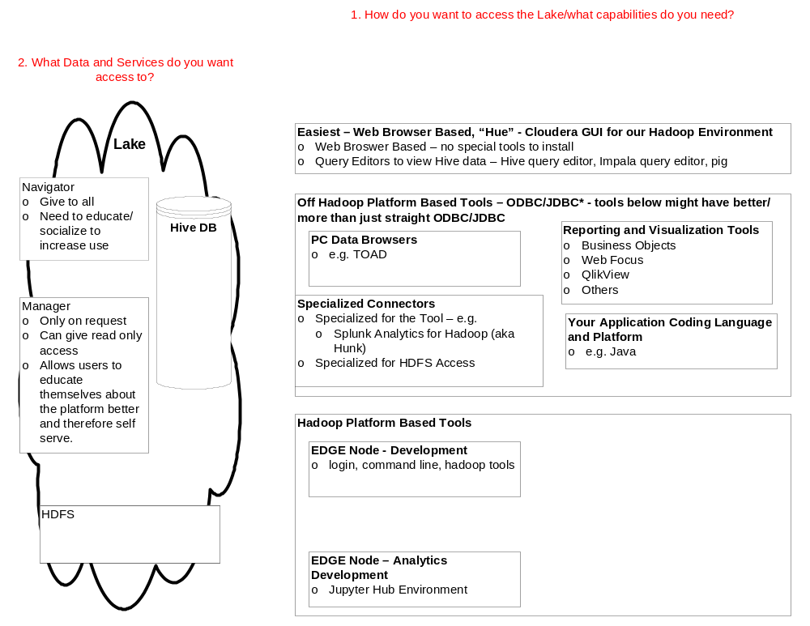
Data Lake Intake - Overview
Last Update: 1/12/2017

